Slide 1
Ecommerce Project
Exploring Payment Gateway and Order List Management

Slide 2
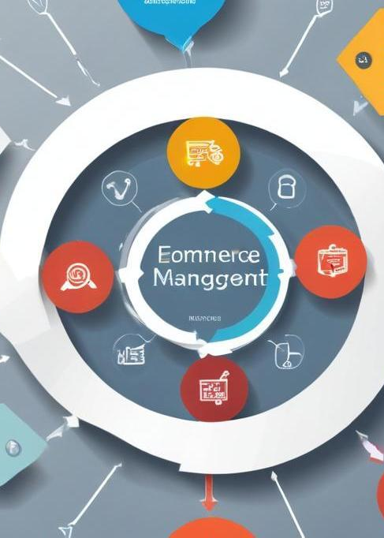
Introduction
This presentation covers essential elements of ecommerce project management, focusing on payment gateways and order list management, key components for successful online sales.

Slide 3
01
Payment Gateway

Slide 4

Definition and Importance
A payment gateway is a service that authorizes and processes online payments for ecommerce. It is crucial for enabling secure transactions between customers and sellers, ensuring customer data is protected, and facilitating a seamless payment experience, thus impacting sales and customer satisfaction.

Slide 5
Popular Payment Gateways
Some of the most popular payment gateways include PayPal, Stripe, Square, and Authorize.Net. Each offers unique features such as different payment methods, fees, integration options, and international currencies, allowing businesses to choose based on their needs.

Slide 6
Integration Process
Integrating a payment gateway involves several key steps: selecting the appropriate gateway provider, setting up an account, obtaining API keys, and implementing the gateway into the ecommerce site's checkout process. Developers often use SDKs or plugins for easy integration. Testing the integration extensively is crucial to ensure all transactions work smoothly before going live.

Slide 7
02
Order List

Slide 8
Components of an Order List
An order list typically includes elements such as order ID, customer details, product images, quantities, prices, and status (pending, shipped, delivered). This information allows businesses to track sales and manage customer inquiries effectively. It's essential for record-keeping and financial reporting.

Slide 9

Managing Orders
Managing orders involves processing incoming orders, updating statuses, handling returns or exchanges, and ensuring timely fulfillment. Using an order management system (OMS) can streamline these processes, automate updates to customers, and maintain accurate inventory levels while minimizing errors and improving efficiency.

Slide 10
Reporting and Analytics
Reporting and analytics allow businesses to gain insights into sales trends, customer behavior, and order fulfillment efficiency. Key metrics may include total sales, average order value, and order cancellation rates. These insights can inform business strategies, enhance customer satisfaction, and optimize inventory management.

Slide 11
Conclusions
Effective integration of payment gateways and efficient order list management are critical for successful ecommerce operations. By understanding these components, businesses can enhance customer experience and streamline their processes for better sales outcomes.

